Slide 1
Mech Design initial ideas

Slide 2
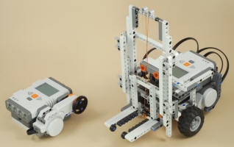
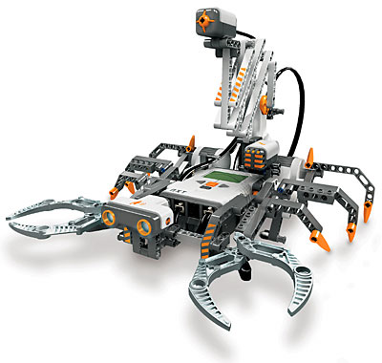

Slide 3
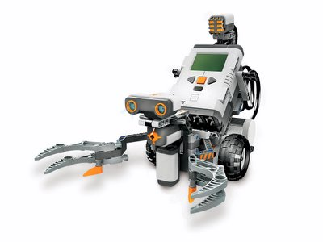
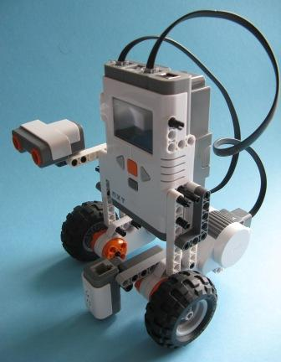

Slide 4
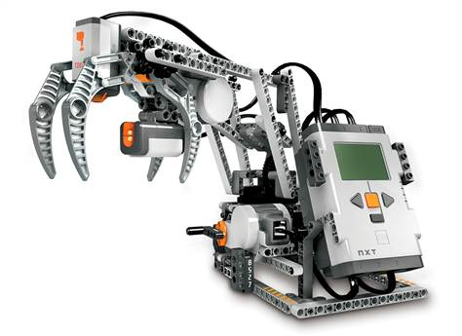

Slide 5
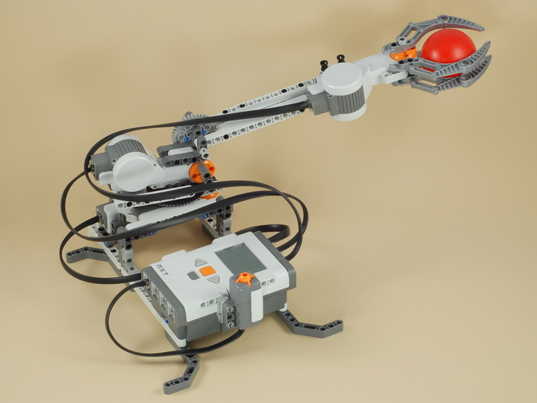
RoboArm (google it)
https://www.google.ca/search?q=robot+arm+nxt&ie=utf-8&oe=utf-8&aq=t&rls=org.mozilla:en-US:official&client=firefox-a
http://www.nxtprograms.com/robot_arm/steps.html

Slide 6
WiredGiraffRobot
Mix between RoboArm’s hand and a crane that we can deploy (or another arm – see book p.229)
http://www.youtube.com/watch?v=msBVSFlgiwA&NR=1&feature=endscreen
http://www.youtube.com/watch?v=Tf6mEf9n9KM&NR=1&feature=endscreen
Best case… http://www.youtube.com/watch?v=vXIUik-7NKo&feature=related

Slide 7
Or… the Snatcher
http://www.youtube.com/watch?v=c2MUd5O6aWc&feature=related
Reverse engineering?

